Slide 1

CONQUERORS
DIVYA SHRI S (LEADER)
9345476575
KEERTHANA R
9360848887
OPEN INNOVATION
PROBLEM STATEMENT
Now-a-days the amount of power consumed by street lights shares a major energy demand. The vehicles are passing over always and a part of places consists of less or even no vehicle movements. But during night all street lights will be on in conventional street lighting system which might result in unnecessary usage of power as the lights will be glowing at full intensity all the times.

Slide 2
ABSTRACT
AUTOMATIC STREET LIGHT CONTROL BY DETECTING VEHICLE MOVEMENT
So to overcome from this issue, a proper energy
saving methods and lighting control should be implemented. The
proposed work is to have two controls like, one is to switch off
lights during no vehicle moments in streets and automatically
switch it on when vehicles arrive and the other modes are to give
less intensity light for pedestrian and to switch on bright mode
during vehicle moments at sides on the roads.

Slide 3
NOVELTY
The control logic is implemented to control lights based on vehicles and pedestrian movements with bright and dim mode of operation and to switch off lights during no movement.
From the proposed method the overall energy used in lighting can be minimized.
As an additional power saving feature, we have used LEDs for street lights.

Slide 4
TECHNOLOGY STACK
In this work photo diodes and IR sensors are used to sense vehicle moments. LED lights are used for street arrangement.
The control signals of sensors have been fed to microcontroller 8051.In the microcontroller the control logic is implemented to control the lights.
MODE 1 : When a vehicle detected moving towards the street the system turns ON a block of street lamps in front of the vehicle. As the vehicle moves forward by, the trailing lamps turn OFF on its own.
MODE 2 :Lights stay ON with ten percent of the extreme intensity of the light when there is no movement. As the vehicle approaches, the block of road lamps change to hundred percent intensity and as the vehicle moves forward by, the trailing lights return to ten percent power once more.

Slide 5
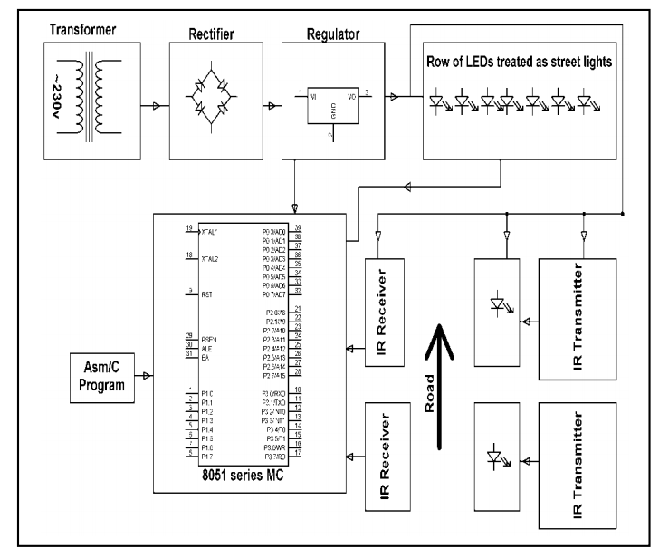
HARDWARE IMPLEMENTATION

Slide 6
HARDWARE DESIGN
The hardware model consists of fourteen light emitting diodes as street lamps.
Eight sets of photodiodes or infrared diodes utilized as sensors.
Variable resistors and transistors which work as switch.
The infrared diodes are set on side of the street and photodiodes are set on the opposite side of the street, straightforwardly confronting IR diodes.
In this IR sensor is used for interruption detection and send logic signal to microcontroller for the glowing of the LEDs ahead of the vehicle.

Slide 7
BUSINESS SCOPE
The implemented model is
Less cost
Pragmatic
Eco friendly and the most secure approach to save energy
This project has scope in different applications like providing lighting for office, building, grounds, walking paths and parking garages of large shopping centers.
This can also be utilized for security surveillance in corporate buildings, businesses centers, school premises etc.

Slide 8
THANK YOU

